Slide 1
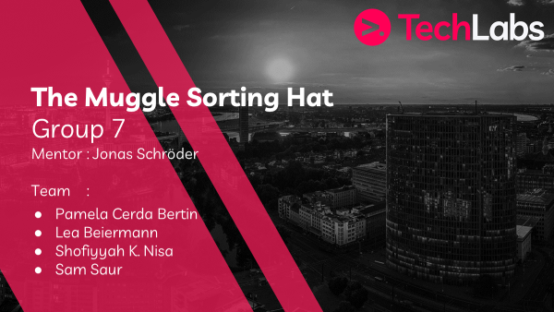

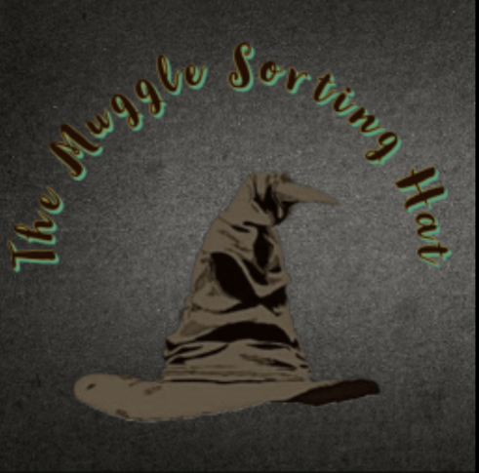
The Muggle Sorting Hat – Group 7

Slide 2
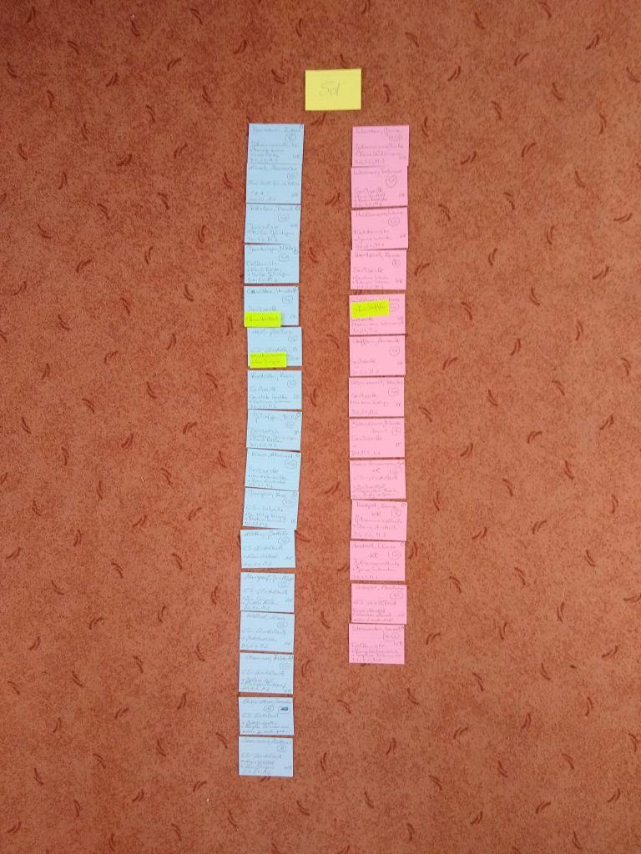
Idea & Project Outline
The Muggle Sorting Hat – Group 7
Our inspiration for our project was a team member’s mother
Create classes
Creating a dataset and grouping students with clustering – scikit learn, NetworkX, Streamlit
Clustering alone was not going to be sufficient
- Creating dataset (3 to 4 weeks) - forming the groups (5 weeks) - coding and integrating the personality test (4 weeks of coding – prep-work of months before coding) - creating a workable GUI prototype (3 weeks)

Slide 3
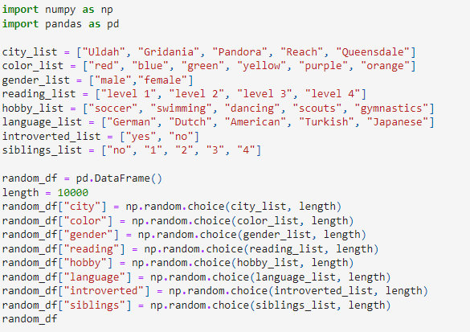



Problems & Solutions
The Muggle Sorting Hat – Group 7
Dataset creation, grouping the students, integration of the personality test
Getting started and finding a way to group the classes
Through the guidance of our mentor, and our brainstorming sessions
->
Excellent expertise, going above and beyond

Slide 4
Learnings
The Muggle Sorting Hat – Group 7
- Stress management, - collaboration through Github – a first for us, - time management
Use additional sources and resources
Hands-on coding and troubleshooting experience
Exceeded our expectations

Slide 5
Demo
The Muggle Sorting Hat – Group 7
Our algorithm successfully creates new classes for the teachers. We also confirmed that the classes were as diverse as possible. Furthermore, we were able to create a workable prototype of our algorithm with streamlit:
[ADD Lea’s prototype here]

Slide 6
Vision board
The Muggle Sorting Hat – Group 7
Bonus! We actually created a visual idea of what our completed app could look like

Slide 7
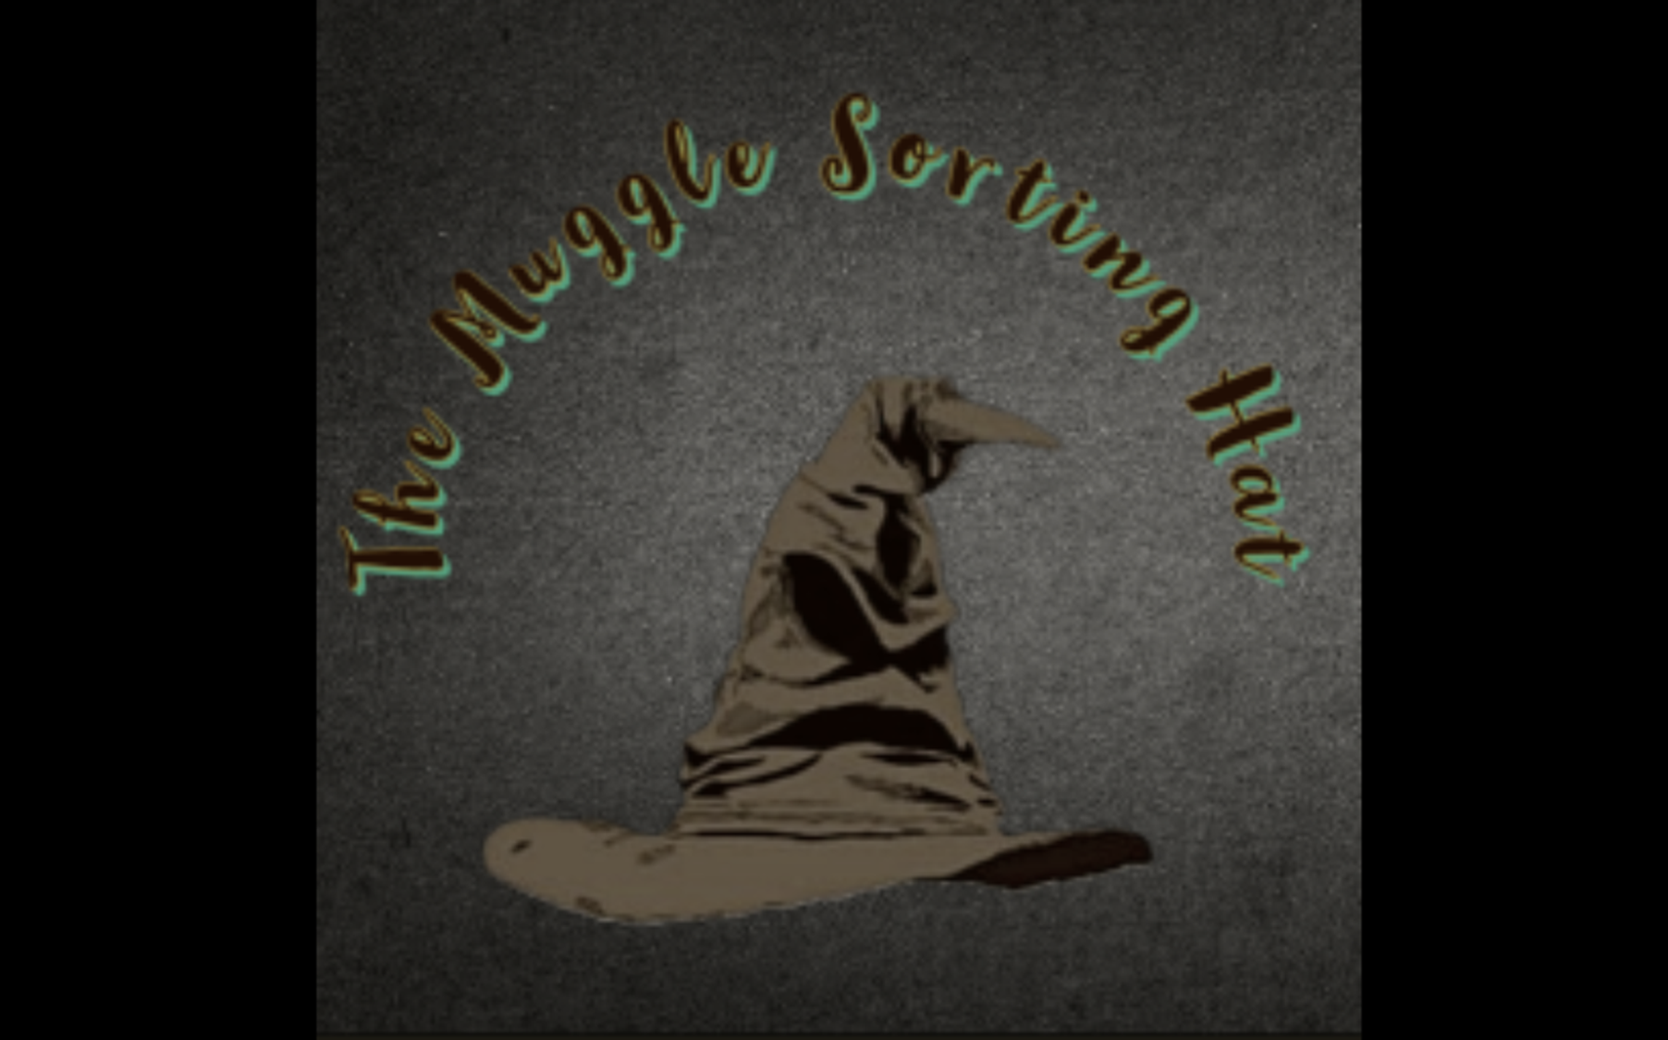
Bonus Content
The Muggle Sorting Hat – Group 7

Slide 8
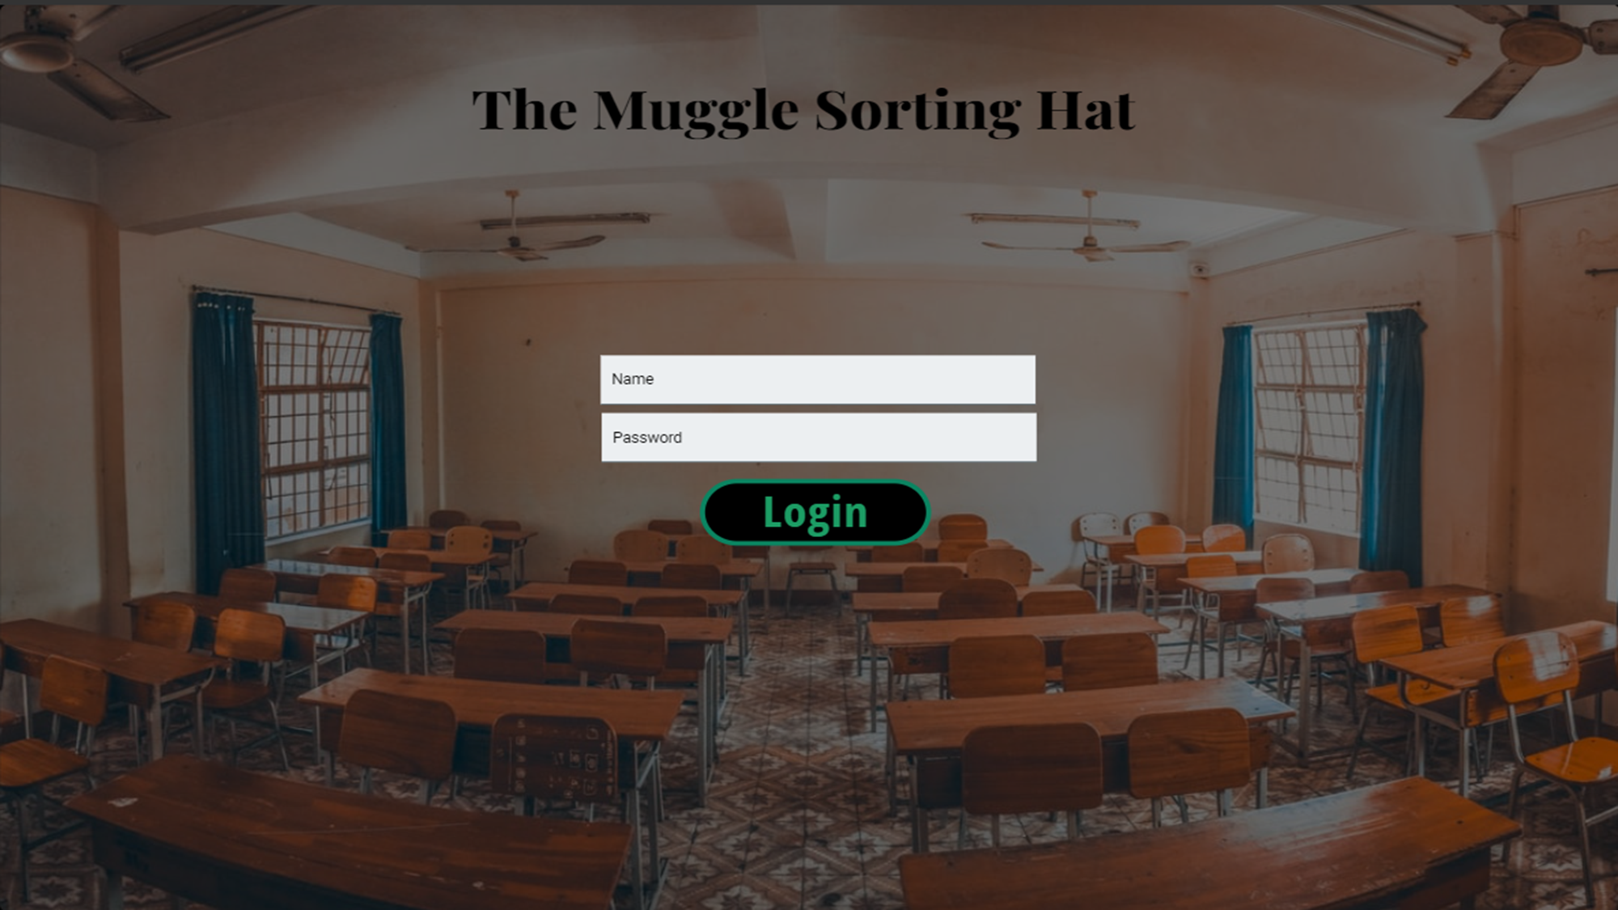
Bonus Content!
The Muggle Sorting Hat – Group 7

Slide 9
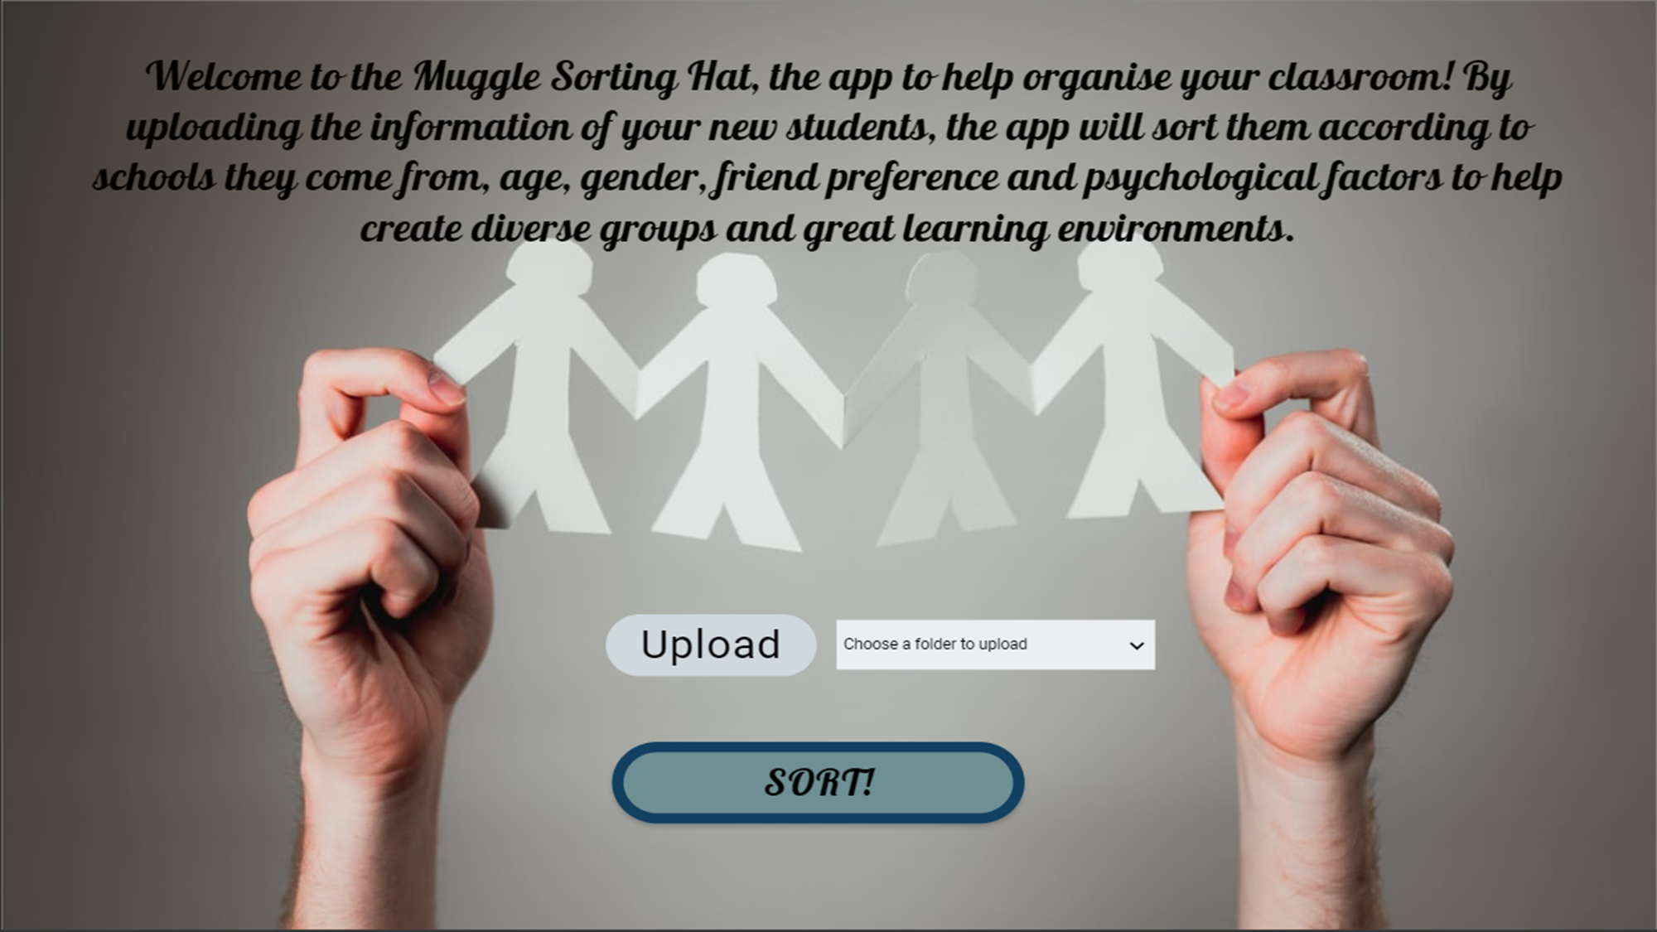
Bonus Content
The Muggle Sorting Hat – Group 7

Slide 10
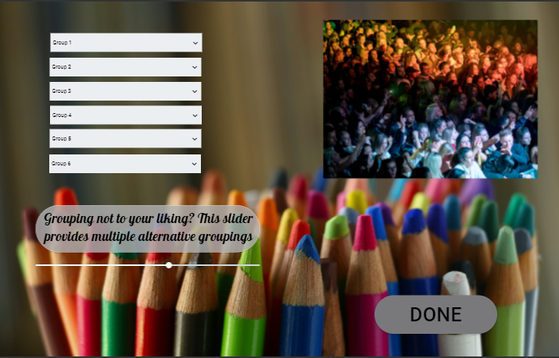
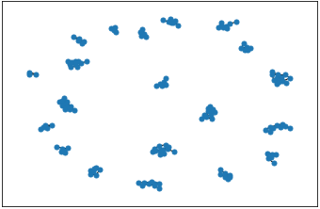
Bonus Content
The Muggle Sorting Hat – Group 7

Slide 11
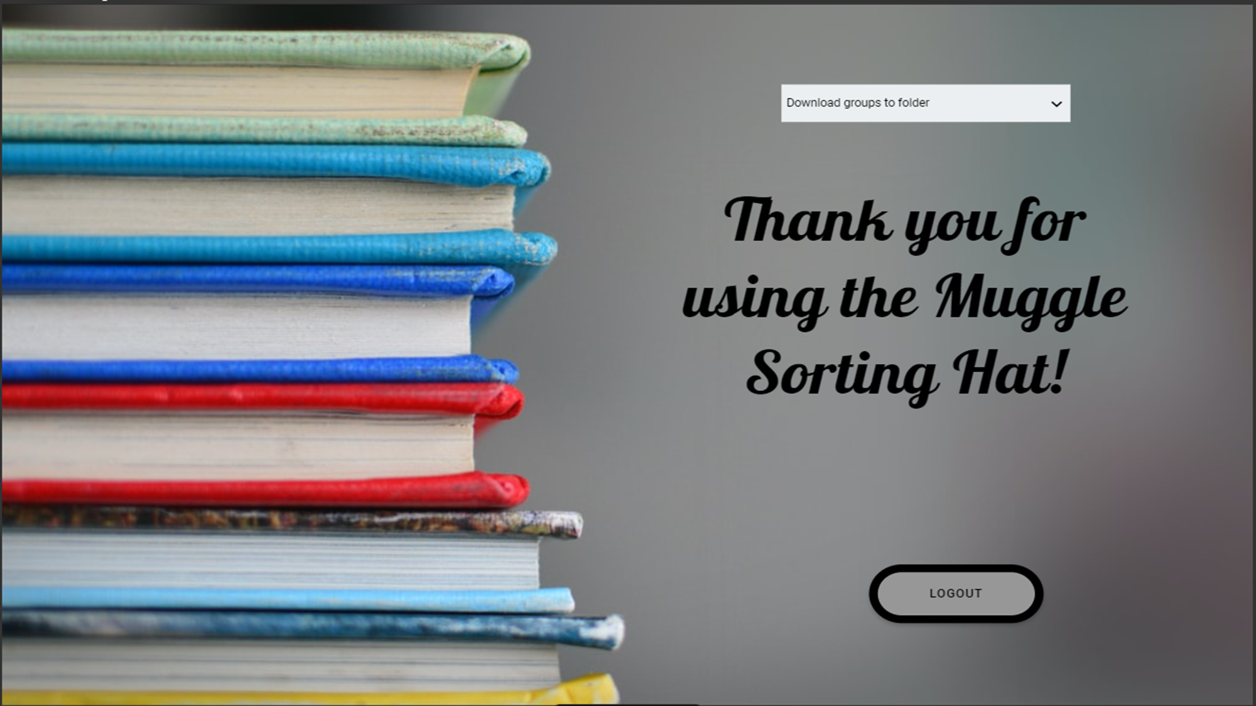
Bonus Content
The Muggle Sorting Hat – Group 7

Slide 12
Thank you for listening to our presentation
Does anyone have any questions?

